Slide 1
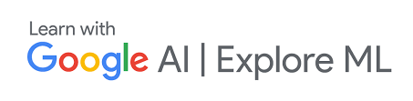
Peaky Blinders

Slide 2
“Eliminate needless blindness!”
–Dr. Venkataswamy

Slide 3
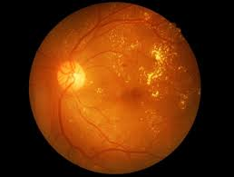
Diabetic Retinopathy Detection
Rohan Sukumaran
Rutvik Vijjali
Srijan V Reddy
Date 20 - 02 - 2020

Slide 4
What is Retinopathy?
Retinopathy is a condition which develops in the eye, which if not treated at early stages, could lead to permanent blindness.
A major contributor towards this condition is diabetes and delayed diagnosis!!!

Slide 5
Why do we care?
India is said to be the diabetic capital of the world by 2030 with over 80 million people affected by it.
Unfortunately, more than 2/3rds of them are from the “subaltern”.
If identified early, this is a blindness which can be avoided.

Slide 6
How are we caring?
A ML model on the edge, with focus on privacy, scalability and interpretability.
Matching cases based on severity and time for immediate diagnosis.

Slide 7
Who is our product intended for?
For rural areas (Tier 4 cities), which has small dispensaries and can afford a fundus camera, but don’t have expert medical professionals available.
A tool for doctors to prioritise cases based on the severity of the condition.
For anyone who wants to make healthcare affordable and accurate.

Slide 8
Technical Roadmap of the System
Gather datasets
Build a Deep learning model
Look at deployment strategies
Build a user interface for the app
Utilise the new data to make the model better

Slide 9
Process Overview
Patient
Our system deployed in clinics.
Retinal Fundus Image
ML Model on the edge
Predictions available on dashboard
Alert Patients
Doctor
Send appointment request based on our analysis + doctors call

Slide 10
Model Overview
Mobilenet_v2 backbone
Fully Connected Network
GradCAM Score matching for heatmaps
Better interpretability of models
Future: Self attention layers to remove CNN from the picture, thereby cutting model params by 10x

Slide 11
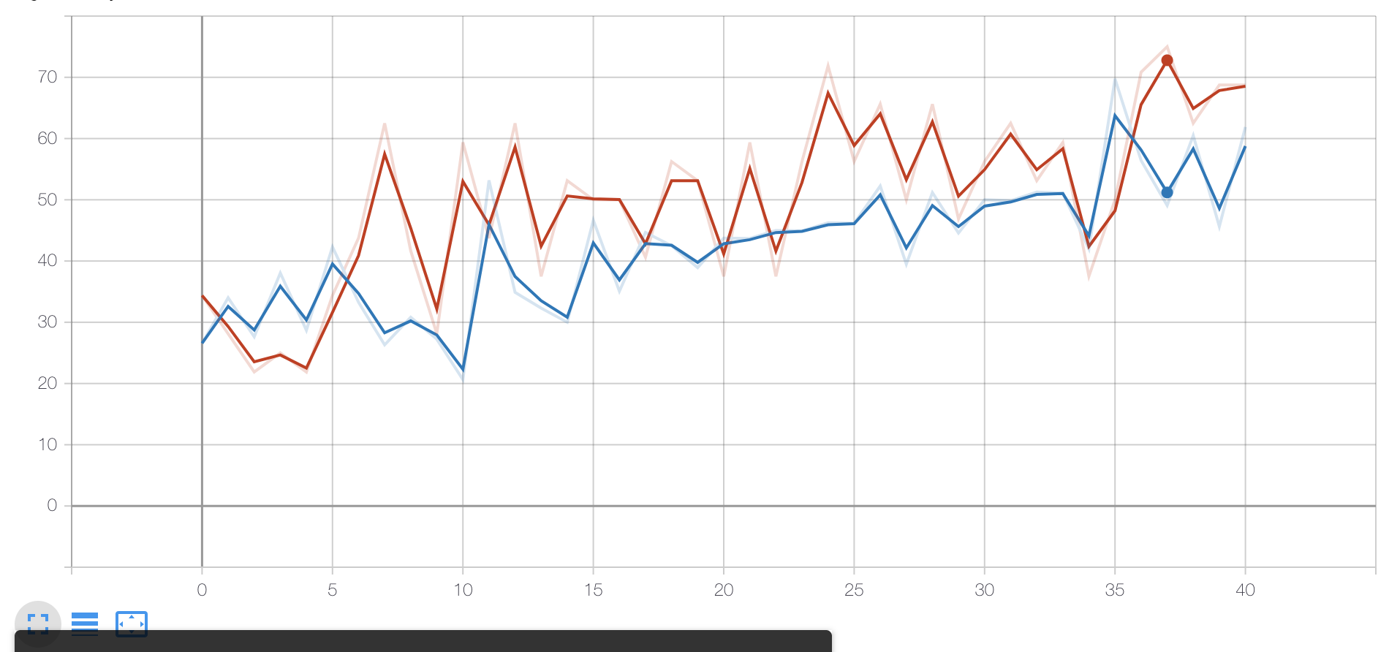
Current Progress
Accuracy of 68% on a production data of 103 images for the base-model. Model was trained on 440 images.
A web-based system for interaction of doctors with clinics.

Slide 12
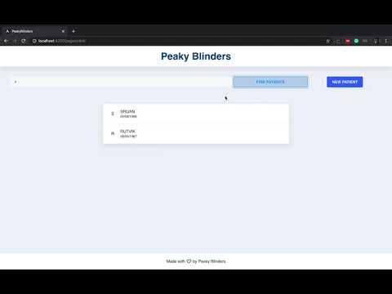
Demo (Clinic View)

Slide 13
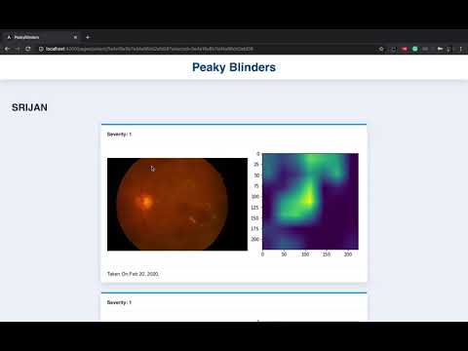
Demo (Doctor View)

Slide 14
Business Plans
Profit sharing, by helping in public health care campaigns, with local hospitals
Charging a very nominal amount for using the software at dispensaries.
“Your data is only your data none of our data ;-)”
Notes:
Predictions at the edge, there by reducing money spent on data privacy concerns

Slide 15
Future Directions:
Deploy on edge devices
Predict more than 5 stage diabetic retinopathy, like other biological conditions based on the retinal image.
Split Learning and Differential Privacy to preserve privacy.
Weak Supervision and Meta Learning algorithms can be used to deploy this for a larger set of images.

Slide 16
Thank You
“Any significant advancement in computer science will be indistinguishable from magic!”
–Arthur C Clarke

